Slide 1

Rajiv Gandhi College of Engineering, Research and Technology
Department of Computer Science and Engineering
REVIEW 2 PROGRESS
SEMINAR ON :
BookAR: Augmented Reality Experience for Traditional Books
Presented By :
Gaurav Khadilkar
Pratik Khairwar
Chetankumar Meshram
Himanshu Sharma
Kaivalya Tannirwar
CSEB802 CSEB803 CSEB814 CSEB844 CSEA850
Guided By : Dr. Nitin Janwe
Project In-charge : Dr. Manisha Pise
Dr. Nitin Janwe
HOD , CSE Dept.

Slide 2
Rajiv Gandhi College of Engineering, Research & Technology, Chandrapur
Department of Computer Science & Engineering
Institute Vision
To be on forefront to impart quality education to address societal and industrial needs and imbibe career skills through perseverance and practice.
Institute Mission
M1. To adapt innovative student centric learning methods based on understanding and practice.
M2.To enhance professional and entrepreneurial skills.
M3.To motivate students to meet dynamic needs of the society with novelty and creativity.
M4.To promote research and continuing education to keep the country ahead.
M5.To promote the mindset to acquire local solutions to local problems (LS2LP). Department Vision To be a centre of excellence in Computer Science & Engineering by imparting knowledge, professional skills and human values.
Department Mission
M1. To create encouraging learning environment by adapting innovative student centric learning methods promoting quality education and research.
M2. To make students competent professionals and entrepreneurs by imparting career skills and ethics.
M3. To impart quality industry oriented education through industrial internships, industrial projects and partnering with industries to make students corporate ready.

Slide 3
Programme Educational Objectives
PEO1: Impart quality industry oriented education, strong fundamentals and problem solving approach through student centric learning methods for product development and handle real time problems.
PEO2: Possess good communication skills and ethics in line with corporate environments to serve the industry & society.
PEO3: Create Competent Professionals & entrepreneurs by imparting Career skills, leadership qualities and research
Program Specific Outcomes:
PSO1: Foundation of Computer System: Ability to understand the principles and working of computer systems. Students can assess the hardware and software aspects of computer systems.
PSO2: Foundations of Software development: Ability to understand the structure and development methodologies of software systems. Possess professional skills and knowledge of software design process. Familiarity and practical competence with a range of programming languages and platforms like Cloud Computing, Web based and Mobile applications, Image and Video Processing, Artificial Intelligence & Machine Learning.
PSO3: Foundation of mathematical concepts: Ability to apply mathematical methodologies to solve computational tasks, model real world problems using appropriate data structures and suitable algorithms

Slide 4
Abstract
The "BookAR: Augmented Reality Experience for Traditional Books" project explores the integration of Augmented Reality (AR) technology with physical books to revolutionize the traditional reading experience.
The project aims to provide a more engaging and dynamic way to consume educational, literary, and instructional content by transforming conventional books into interactive and multimedia-rich learning tools.

Slide 5
INTRODUCTION
AR BOOKS uses Augmented Reality (AR) to bridge the gap between traditional books and digital media.
It overlays digital content onto the physical pages, enhancing the reading experience.
This project enhances physical books with interactive 3D models, animations, and videos, making learning and storytelling engaging.

Slide 6
Modules
Module 1 : Book Upload and File Handling: Handles uploading and processing of PDF files.
Module 2 :AR Content Mapping: Associates specific book pages with corresponding AR content.
Module 3 : Marker Recognition: Detects and triggers AR content using page markers.
Module 4 : 3D Rendering and User Interaction: Renders interactive 3D models and animations using A-Frame and AR.js.

Slide 7
BookAR Project – Second Module
CONTENT MAPPING
The AR Content Mapping Module in BookAR project is designed to link the pages of a physical book with augmented reality (AR) content, providing an immersive and interactive experience for users. Here’s a detailed explanation of how this module works:

Slide 8
Key Functions of the AR Content Mapping Module
User Interaction and Page Selection:
The module provides a user interface where users can select a specific page of the book using a dropdown menu.
The dropdown menu is populated dynamically with the number of pages extracted from the uploaded PDF (handled in the first module).
Uploading AR Content:
Users can upload various types of digital AR content, such as: 3DModels, Animations ,Videos ,Audio, Images .
The uploaded AR content is linked to the selected page in the PDF, ensuring the right digital content is associated with the correct page.

Slide 9
Mapping AR Content to Pages:
When AR content is uploaded and a page is selected, the module creates a mapping between the page and the digital content.
This mapping information is stored in an object (arContentMap), where the page number is the key and the content file name is the value.
The mapped AR content is displayed in a list to show which pages have associated AR content.

Slide 10
CONTENT PREVIEW
BookAR offers an interactive augmented reality experience that enhances traditional reading.
This system allows users to upload any physical book, enabling AR content to be overlaid when users scan book pages.
The content preview features 3D models, videos, animations, and more, bringing each page to life.

Slide 11
EDIT MAPPING
Editing Mapping is the process of associating AR content with specific pages of the book.
The editing process allows the creation of dynamic AR experiences for various books.
AR models, videos, and interactive features can be mapped to specific book pages using custom markers or QR codes.

Slide 12
Remove Mapping
Removing AR content mapping is equally important for managing the AR experiences.
If a user wants to disable AR content or update the mapping to new markers, the system allows easy removal and reconfiguration.
This feature ensures flexibility and provides control over what content is displayed with each book.

Slide 13
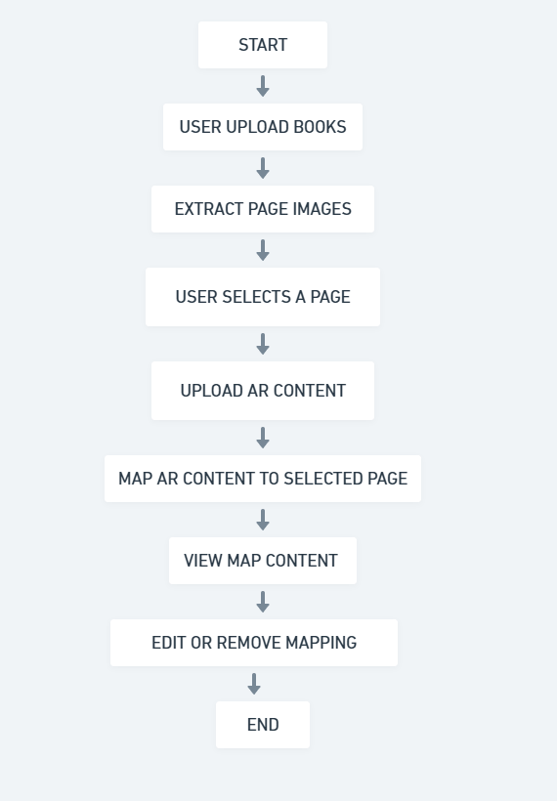
AR Content Mapping Flowchart

Slide 14
The AR Content Mapping Module in BookAR enables users to map digital AR content to specific pages of an uploaded PDF book. The system extracts page images, which serve as markers for AR recognition.
Users then select a page and upload AR content such as 3D models, videos, audio, or images. The mapping is stored in a database, allowing users to preview their AR content, view existing mappings, and edit or remove them as needed.
This ensures an interactive AR experience without requiring external markers or cameras, as the book’s own pages act as the tracking elements for AR visualization

Slide 15
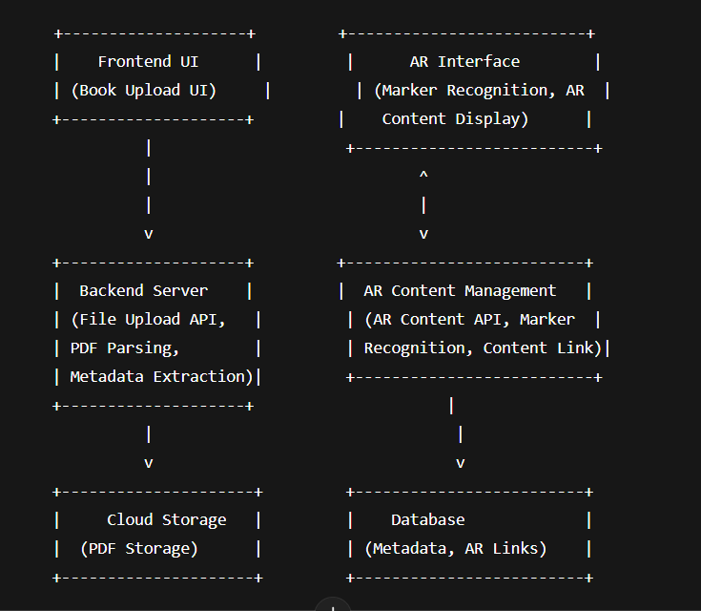
Architectural Diagram for AR Content Mapping

Slide 16
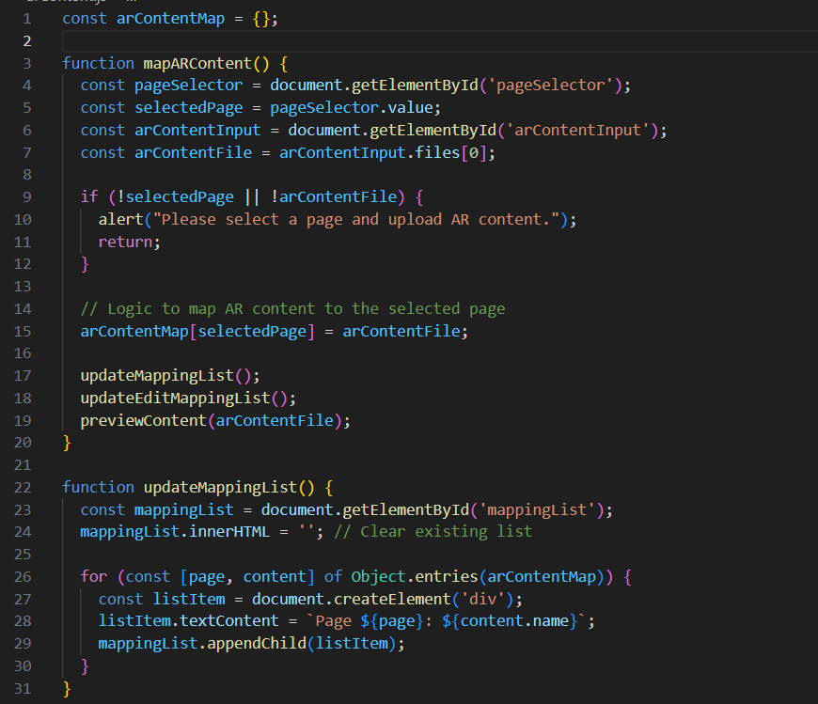

Slide 17
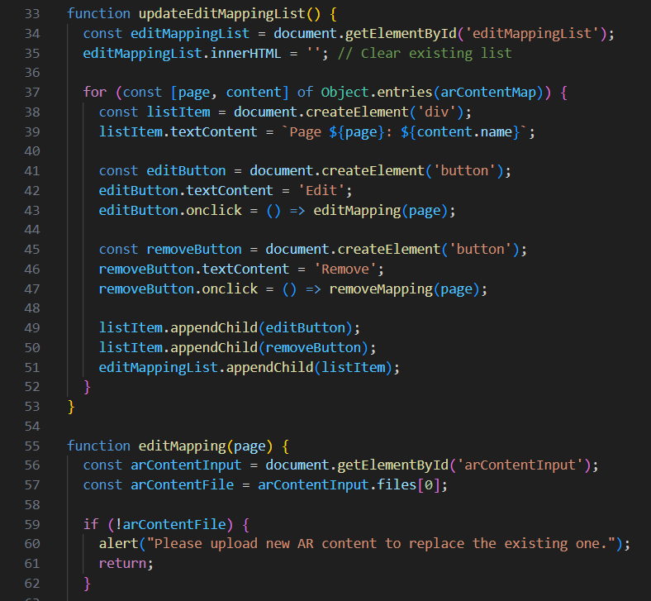

Slide 18
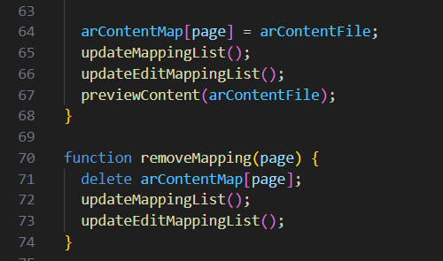

Slide 19
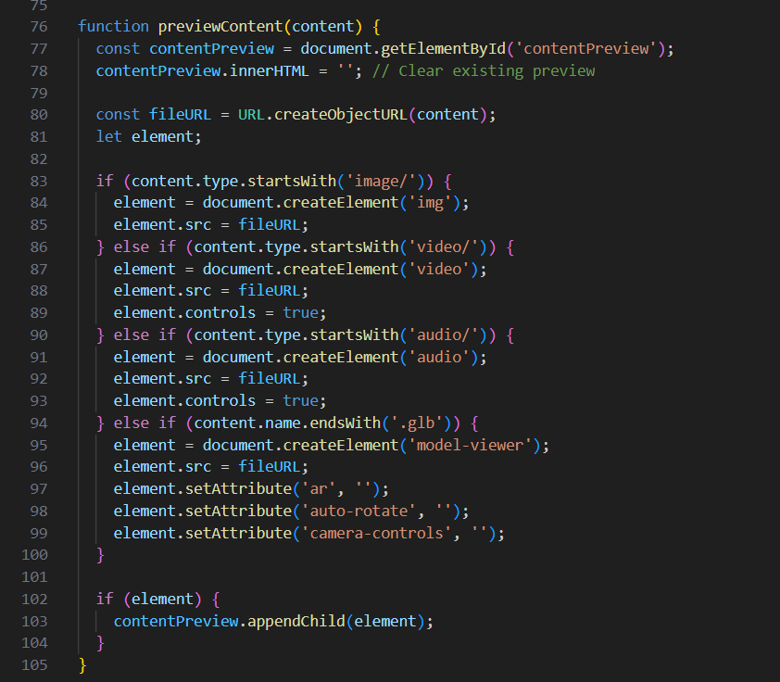

Slide 20
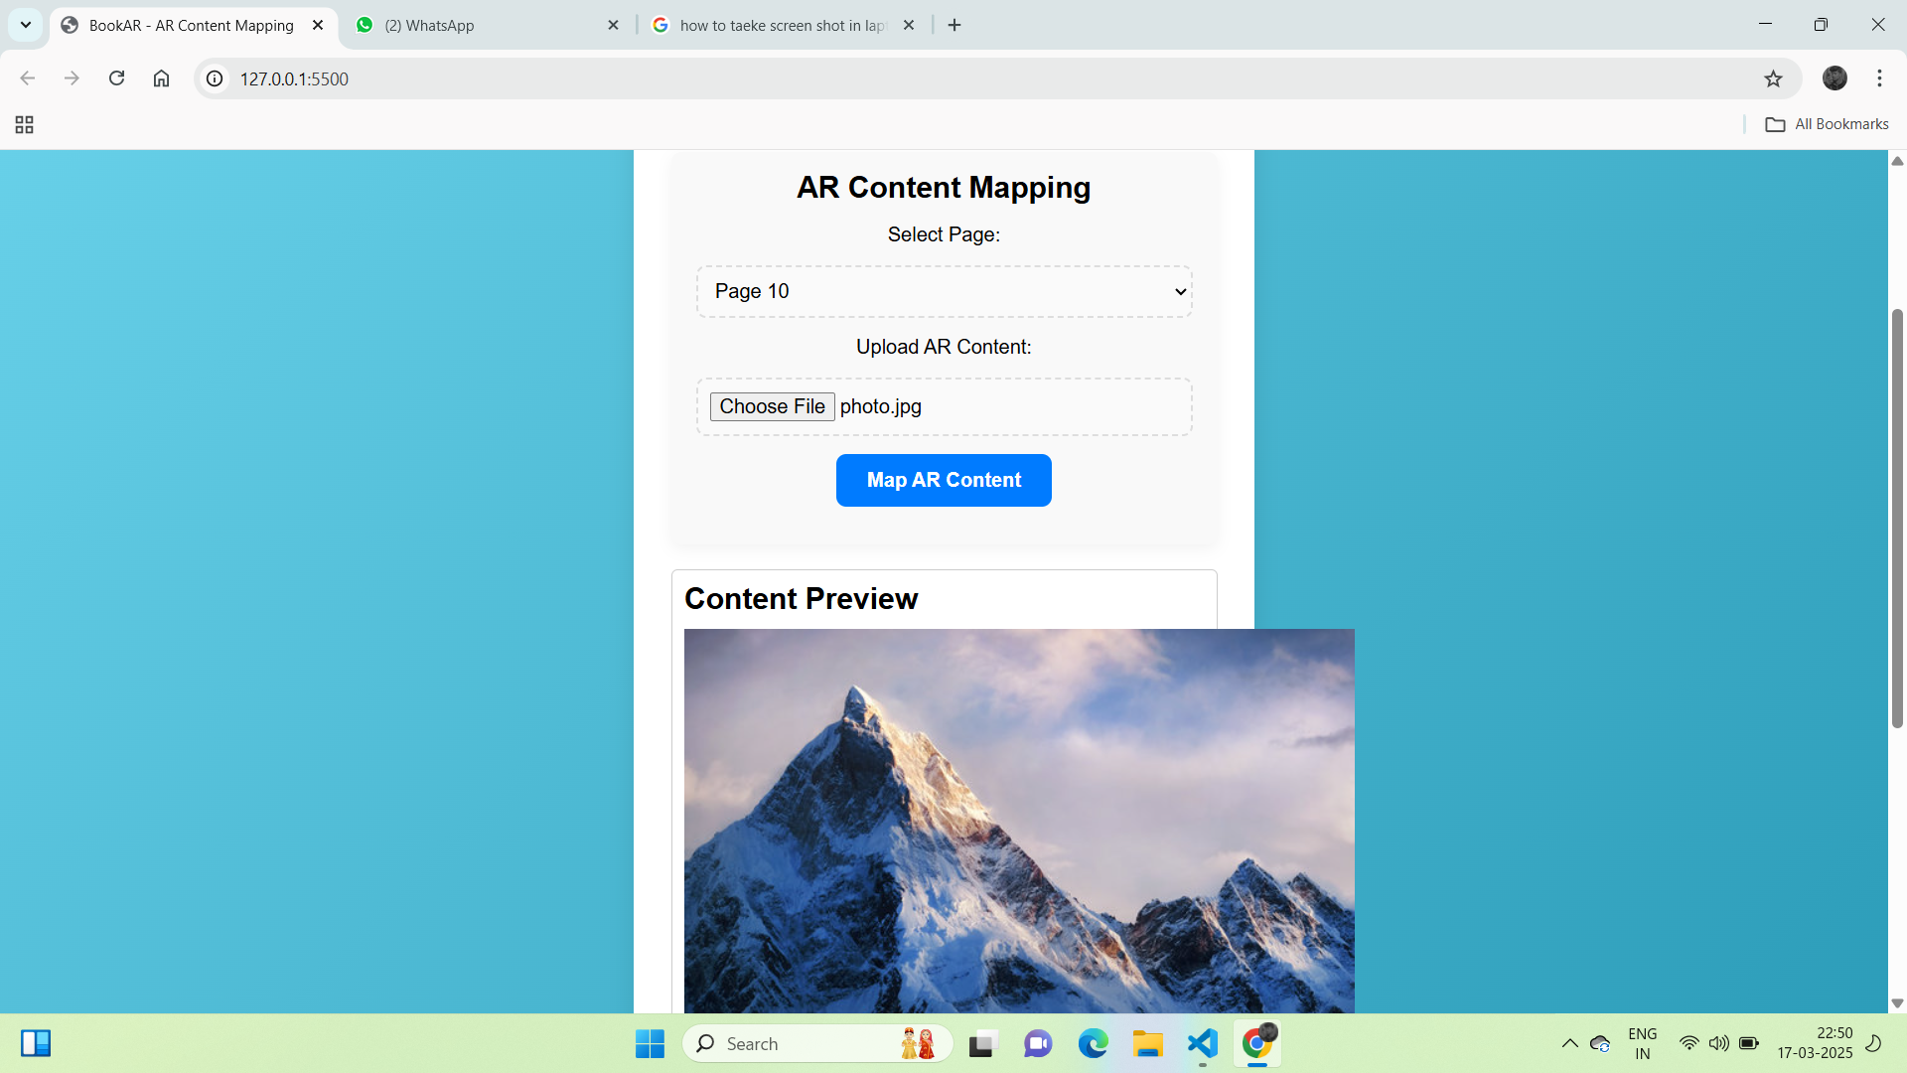

Slide 21
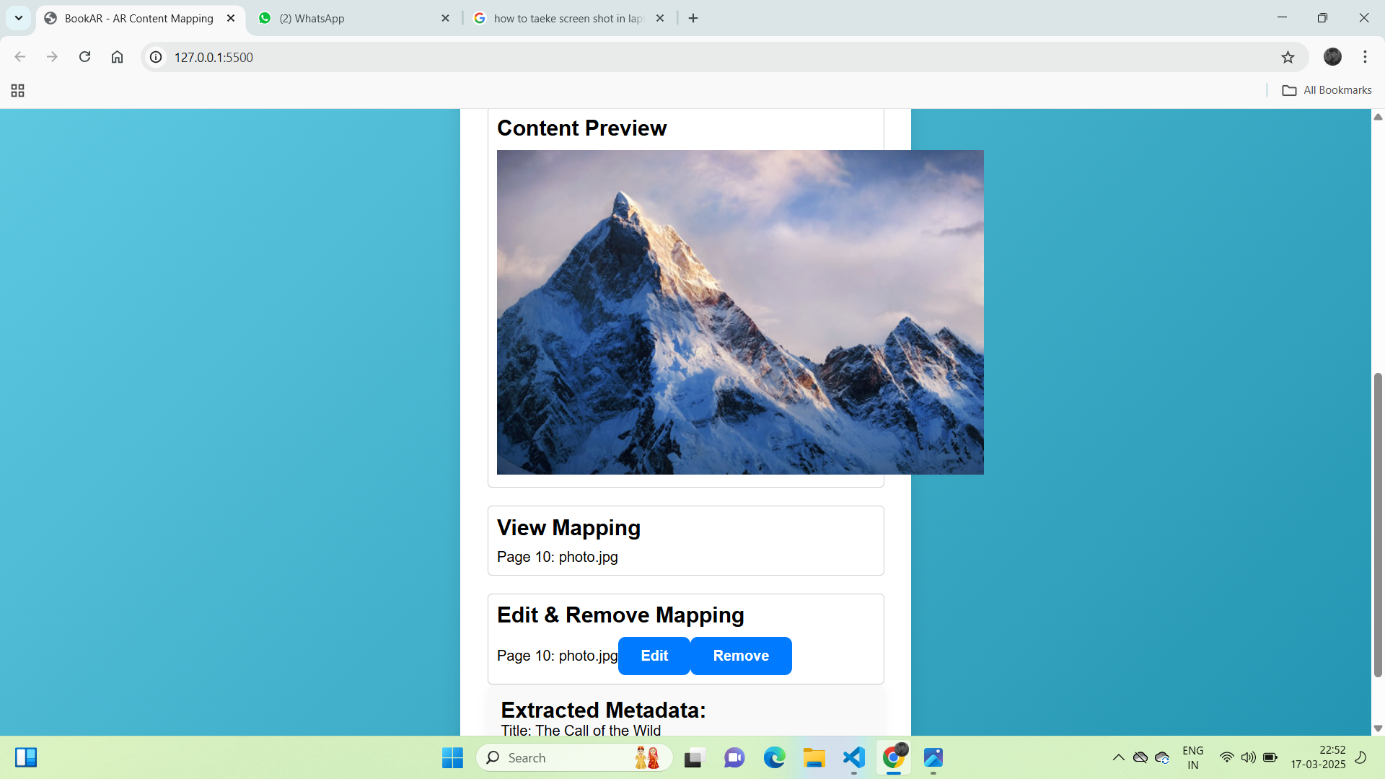

Slide 22
References
Alyousify, A. L., & Mstafa, R. J. (2022). AR-assisted children's book for smart teaching and learning of Turkish alphabets. Virtual Reality & Intelligent Hardware, 4(3), 263–277.
Adhikari, A., Tamang, R. R., & Thapa, A. (2020). AR Book: Learnopedia. International Research Journal of Modernization in Engineering, Technology and Science, 2(6), 729–739.
Cai, S., Wang, X., Gao, M., & Yu, S. (2012). Simulation Teaching in 3D Augmented Reality Environment. IIAI International Conference on Advanced Applied Informatics, 83–86.

Slide 23
THANK YOU

